Slide 1



2025
Boreal DronePort
Demola Project

Slide 2

2025
Mission
Vision
Our mission is to fill a critical gap in the market by developing a fully autonomous drone base, engineered for extreme Nordic conditions. Designed to operate flawlessly with minimal maintenance, our solution delivers superior quality and reliability in both remote wilderness and urban environments — reducing costs and maximizing operational efficiency.
We envision a future where fully autonomous drone bases enable seamless air surveillance in any environment, with minimal human intervention. Our goal is to make high-performance, Arctic-proof drone infrastructure available to anyone who needs reliable, cost-effective aerial operations.

Slide 3

2025
Boreal DronePort One
For single drone
Boreal DronePort Nine
For multiple Drones
A modular, stackable, and climate-controlled base designed for single-drone operations.
Engineered for mobility, minimal thermal footprint, and autonomous deployment in the harshest environments.
A modular, climate-controlled base designed to support up to 9 drones for continuous, high-demand operations.
Engineered for multi-drone operation, reliability, minimal thermal footprint, and autonomous performance in the harshest environments.

Slide 4

Company Name
DronePort One
For single and multi drones
2025
Key Features
Stealth Design: Minimal thermal footprint – invisible to thermal cameras.
Climate Control: Optimal temperature & humidity for batteries, electronics, and lenses – prevents fog and ensures performance.
Modular & Stackable: Single or multi-unit deployment.
Portable: Lightweight for fast and easy deployment.
Elevated Structure: Ground-free with adjustable legs for any terrain.
Auto-Charging: Charges drone’s battery between missions.
Landing Camera: Ensures precise, secure docking.
LED Lighting: Reliable operation in dark enviroment.
Weather Monitoring: External weather station for real-time wind, humidity & temperature.

Slide 5

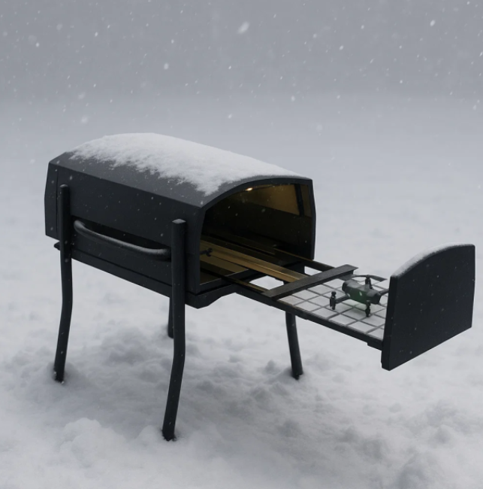
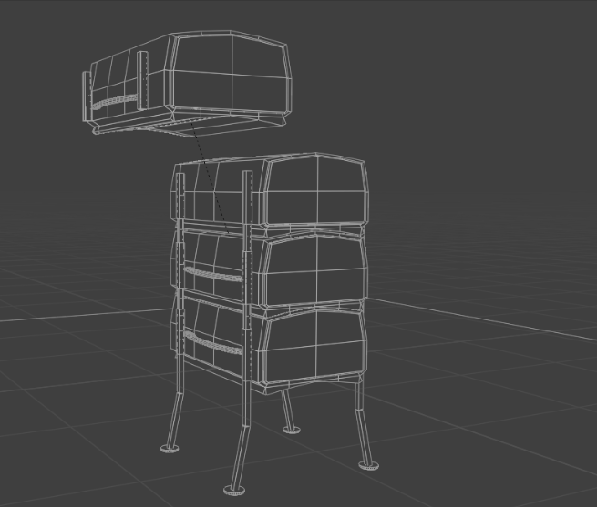
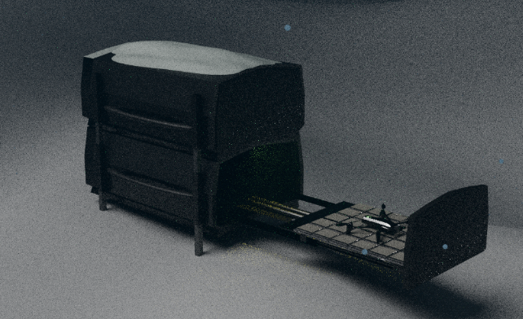
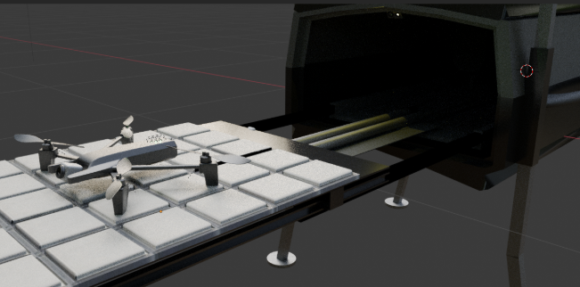
2025
DronePort
One

Slide 6
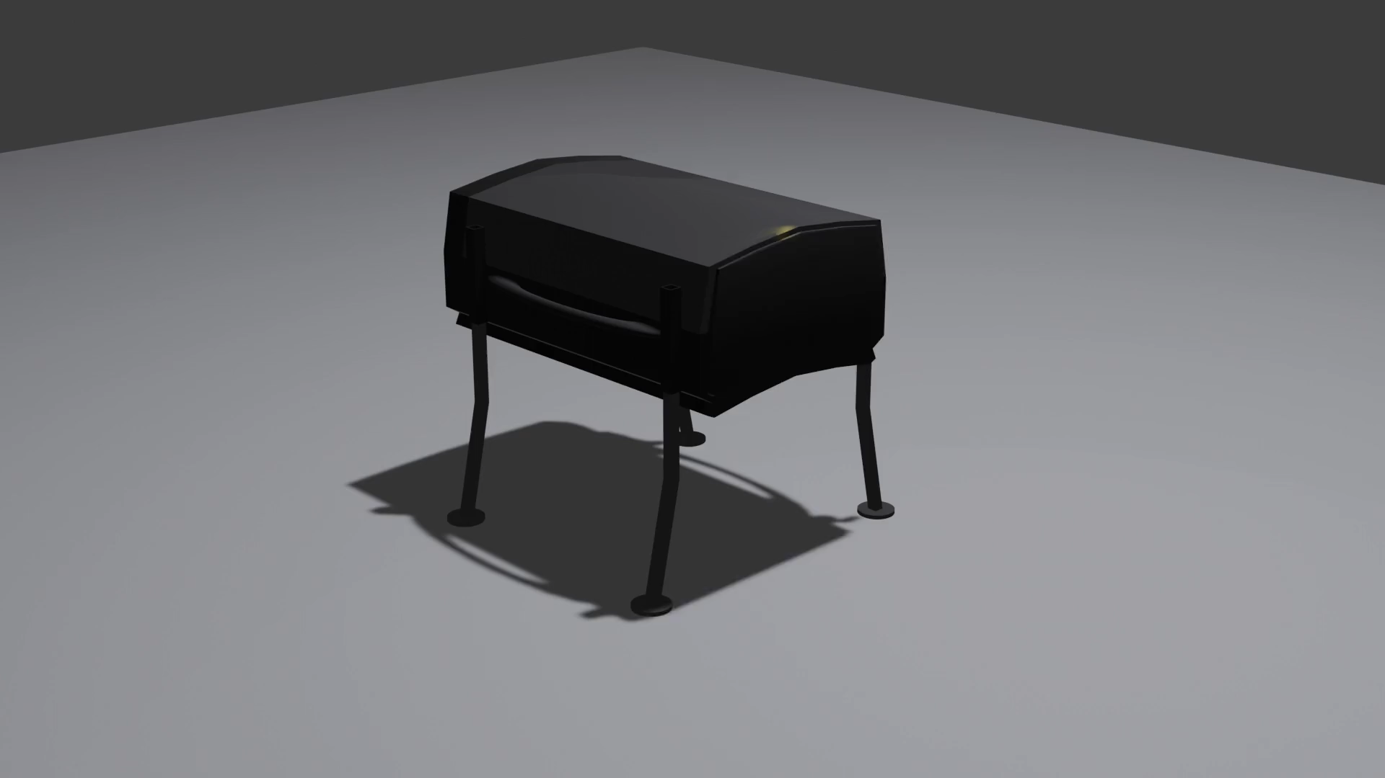
2025
DronePort
One

Slide 7
DronePort Nine
For multiple Drones
2025
Key Features
Capacity for 9 Drones: Centralized base for high-demand aerial operations.
Simultaneous Charging: Charges all drone’s built-in batteries efficiently.
Climate Control: Optimal temperature & humidity for batteries, electronics, and lenses – prevents fog and ensures performance.
Dual Access Doors: Two-part hatch system ensures drone access even in snow or ice conditions.
Compact Drone Housing: Minimal individual modules maximize internal space.
Scalable for Large Missions: Ideal for continuous, multi-drone surveillance.
Stealth Design: Low thermal footprint, hard to detect with thermal imaging.
Backup Power: Integrated power supply for short outages – uninterrupted operation.

Slide 8
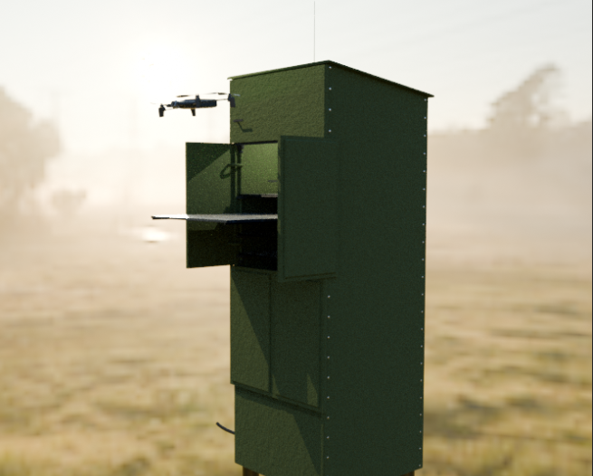
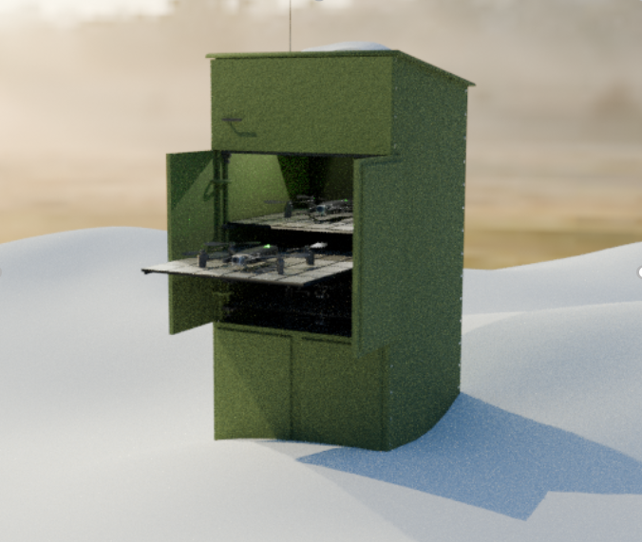
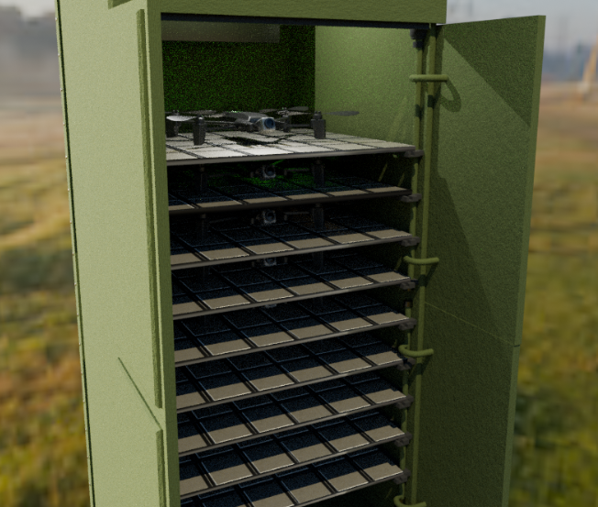
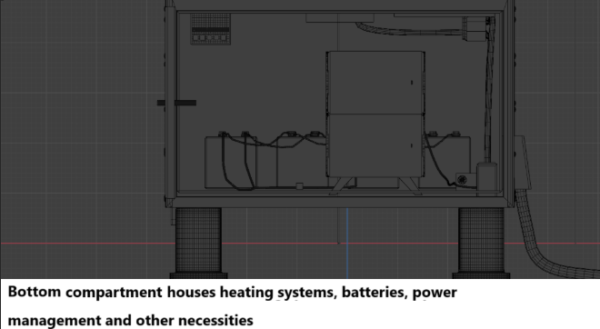
2025
DronePort
Nine

Slide 9
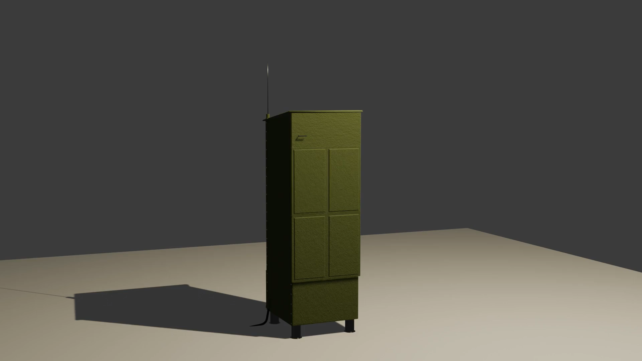
2025
DronePort
Nine

Slide 10
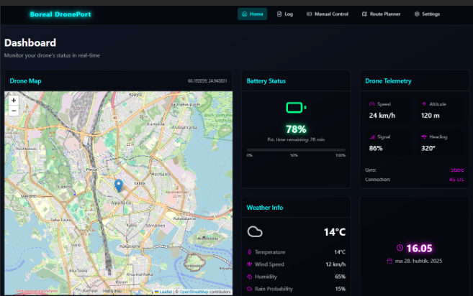
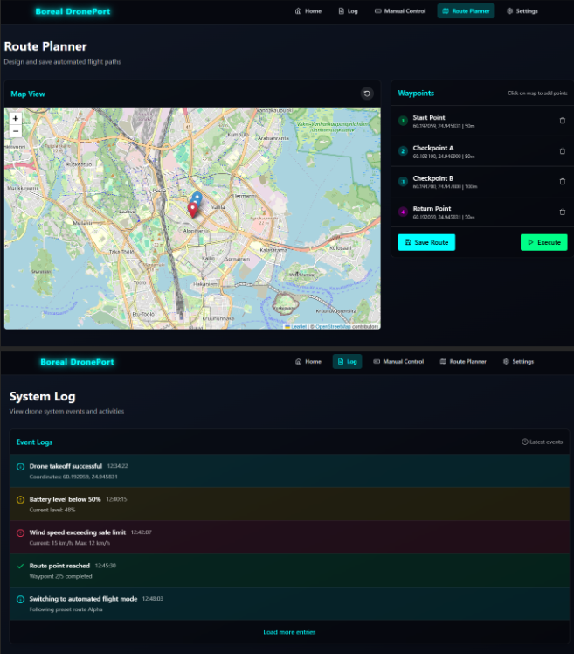
DronePort UI
For Managing operations and base
2025

Slide 11

Company Name
2025
“
Sky is full of possibilities

